Slide 1
IBM University Engagement Project Submission
“Exploring the Power of Agentic AI with IBM Granite and LangFlow”

Slide 2

Project Tile – AI-Powered Autonomous Interview Trainer Agent
Domain of Project – Education / Career Development
Student Name | Recent Passport Photo | Email ID | Mobile number [WhatsApp]
Chetanya prakash |  | chetanyapr@gmail.com | 8791189856

Slide 3
Problem Statement -
Problem Statement : Interview Trainer Agent
The Challenge
Traditional mock interview platforms rely on static question sets that fail to adapt to a candidate's personal profile, experience layer, or target technical role. Engineering graduates face severe confidence gaps and poor hiring conversion rates because current prep tools lack localized feedback loops, domain-grounded context, and behavioral alignment matching enterprise hiring benchmarks.
The Objective
Build an AI-powered Interview Trainer Agent that delivers personalized mock interviews and actionable guidance for students, job seekers, and career professionals. The solution should:
Tailored Question Generation – Recommend specific interview question sets based on profile name, experience level, technical stack, and target job role.
Recruitment Data RAG Retrieval – Fetch and summarize role-specific interview queries, behavioral scenarios, and HR guidelines from verified recruitment databases.
Real-Time Assessment & Feedback – Provide instant evaluation metrics, model answers, and custom improvement tips for candidate responses.
Comprehensive Skill Focus – Conduct exhaustive assessments covering both deep technical concepts and essential soft skills.
Performance Visualization Dashboard – Show dynamic tracking metrics, category-wise skill proficiencies, and overall readiness for competitive hiring environments.

Slide 4
Technology Used
Orchestration Framework: Langflow
Enterprise AI Cloud Platform: IBM watsonx.ai Studio
Foundation LLM Model: IBM Granite (ibm/granite-8b-code-instruct)
Vector Database: Chroma DB
Embedding Generator: IBM watsonx.ai Embeddings API
Core Backend Environment: Python Ecosystem (Text Splitters & Data Utilities)

Slide 5
Proposed Solution -
Proposed Solution: AI-Powered Interview Trainer Agent
The proposed solution is a multi-agent AI-powered Interview Trainer Agent built using LangFlow, IBM watsonx.ai, and Granite Models to provide personalized, real-time interview guidance. The system addresses challenges in interview preparation, technical profiling, and soft-skill development through an intelligent, modular architecture.
At its core, the solution uses a Retrieval-Augmented Generation (RAG) pipeline to fetch accurate behavioral rubrics and technical criteria from trusted sources such as recruitment databases, professional portals, and company interview logs. This data is embedded and stored in a vector database, enabling the system to retrieve and summarize structural interview frameworks using Granite models.
The system consists of four keyagents:
Interview Knowledge Agent retrieves and summarizes domain-specific technical parameters using RAG.
Question Generation Agent generates personalized mock interview questions based on user inputs such as profile name, experience level, and job role.
Response Evaluation Agent provides real-time assessment of technical and soft skill proficiency, including model answer mapping.
Coaching & Feedback Agent delivers instant tactical metrics and actionable improvement tips to build user confidence
The solution includes a performance visualization dashboard (built with Streamlit or React) that visualizes interview progress, highlights structural skill deficiencies, and tracks readiness toward hiring goals. LangFlow is used to orchestrate agent workflows, while watsonx.ai ensures scalable model deployment, embeddings, and AI governance. Granite models power reasoning, summarization, and contextual evaluation.
Overall, this solution delivers an end-to-end intelligent interview assistant that promotes career success through personalized insights, real-time feedback, and comprehensive interview preparation.

Slide 6
Langflow component Used -
Chat Input – Interface where users enter their target job roles, profile details, and interactive conversational answers during the mock session.
IBM watsonx AI Agent - Processes candidate inputs using Granite models to orchestrate the multi-turn technical interview loop, generating structured situational evaluations.
Name of IBM Granite model - ibm/granite-8b-code-instruct $\rightarrow$ Enterprise-grade model deployed for dynamic code parsing, stateful logical reasoning, and objective answer evaluation.
Chat output - Displays AI-generated output streams including technical question loops, grading responses, model answers, and constructive feedback dashboards.
File component - Ingests the localized structured query database (interview_qa_dataset.csv) and technical rubrics directly into the runtime pipeline.
Chroma DB (Vector DB) - Functions as the high-speed semantic storage unit that indexes text splits and coordinates fast cosine-similarity search lookups for the RAG loop.
Split Text & Stringify Nodes - Parses extensive dataset blocks into exact windows (Chunk Size: 1000, Overlap: 200) and formats multi-agent data payloads into clean textual inputs.

Slide 7
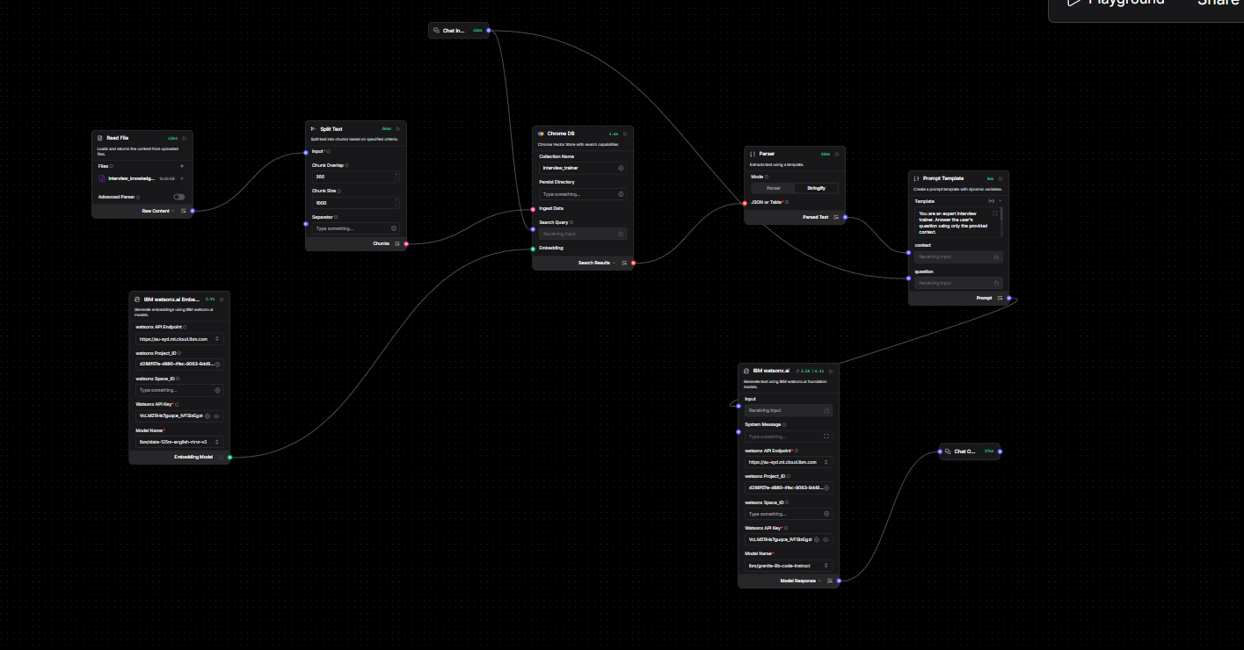
Langflow workflow -

Slide 8
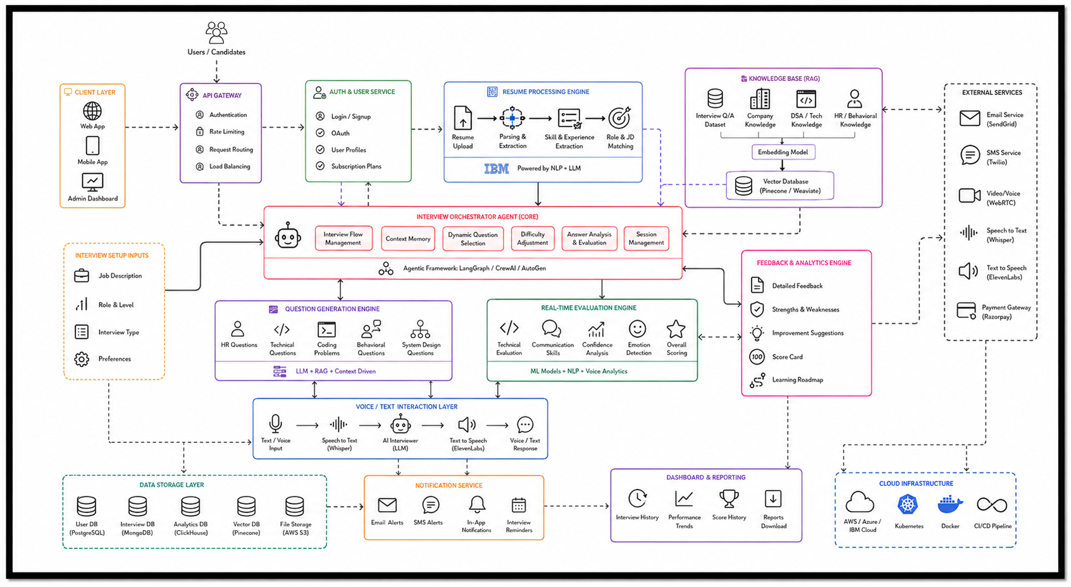
Architecture blueprint

Slide 9

Role of Agentic AI in the solution
Role of Agentic AI in Interview Trainer Agent
Agentic AI enables the Interview Trainer Agent to function as an intelligent, autonomous system rather than a simple chatbot. Using IBM watsonx.ai and IBM Granite models, it coordinates multiple specialized agents to deliver personalized mock interviews and evaluation guidance. Each agent performs a specific role—such as retrieving recruitment criteria, generating tailored question sets, providing real-time evaluation, and coaching candidates—while working collaboratively. This multi-agent approach ensures efficient task execution and highly accurate results.
Agentic AI also brings context awareness, understanding user details like profile names, target tech stacks, and experience levels to generate tailored interview loops. It supports real-time adaptation, continuously updating follow-up questions and cross-questioning based on the user's previous answers. Additionally, agents communicate with each other, enabling better decision-making, strict verification, and improved preparation outcomes. Overall, Agentic AI makes the system proactive, personalized, and goal-driven, acting like a smart digital tech interviewer that helps users excel in competitive hiring loops.

Slide 10
Technology Used
Langflow platform - For designing and orchestrating multi-agent interview loops and workflow pipelines visually.
IBM Granite model - For example: ibm/granite-8b-code-instruct – For context understanding, logical evaluation, adaptive code-based reasoning, and deep response validation.
IBM Cloud - It provides the infrastructure to host, manage, and scale the application securely. IBM Cloud enables a reliable, secure, and scalable environment for executing AI tokens.
RAG (Retrieval-Augmented Generation) - Implemented to fetch structured recruitment rubrics first, then generate intelligent answers, making the evaluation benchmarks trustworthy and accurate.
IBM watsonx.ai - For foundation model access, dense vector embeddings generation, and strict AI governance.
Vector Database (Chroma) - For fast RAG-based context retrieval and cosine-similarity searches of technical domain question sets.

Slide 11
Novelty and Uniqueness
The proposed Interview Trainer Agent stands out by combining Agentic AI, RAG, and personalization into a single intelligent system.
Multi-Agent Intelligence – Instead of a single static chatbot, multiple specialized agents (Knowledge, Question, Evaluation, and Coaching) collaborate to deliver accurate and context-aware mock interviews.
RAG-Based Accuracy – Integrates real-time retrieval of hiring criteria with AI generation, reducing generic responses and ensuring trustworthy, industry-aligned evaluation benchmarks.
Hyper-Personalization – Tailors technical question sets and difficulty scaling based on the user's specific target job role, technical stack, and experience level.
Real-Time Feedback Loop – Continuously adapts the flow of cross-questioning based on previous user responses and delivers instant evaluation metrics with model answers.
Multi-Modal Assessment – Supports dynamic text-based dialog exchanges and structures structural logic processing paths for deep-dive skill assessment.
Comprehensive Skill Focus – Goes beyond standard technical testing to provide contextual analysis covering both complex programming frameworks and critical soft skills.
Scalable & Enterprise-Ready – Built on IBM watsonx.ai with IBM Granite models, ensuring extreme processing reliability and optimal data governance.
This makes the solution a smart, adaptive, and proactive digital tech interviewer, not just a static question recommendation tool.

Slide 12
Git Hub Link
working Github URL –https://github.com/chetanyapr-sys/AI-Interview-Trainer-Agent/blob/main/README.md
·
·
·

Slide 13
Future Scope
Integration with Native Speech-to-Text & Communication Channels –The system can be integrated with real-time voice modules and popular communication platforms to collect audio datasets such as tone variations, communication pacing, and verbal hesitation patterns. This will enable the Interview Trainer Agent to provide more accurate and dynamic soft-skill recommendations based on actual vocal parameters and confidence metrics.
AI-Powered Resume Parsing & Multilingual Support –Enhancing the system with automated candidate PDF parsing and support for multiple regional or international coding instructions will improve accessibility. Users can interact naturally and analyze custom resume pipelines in their preferred environment, making the solution more inclusive and suitable for diverse engineering candidates, especially in domains with varied tech-stack backgrounds.
·
·
·

Slide 14


